Slide 1
SOFTWARE CONFIGURATION MANAGEMENT

Slide 2

Software Configuration Management Tools

Slide 3
Software Configuration Management Tools
Software Configuration Management Tools are the tools and utilities used in administering source code, building software, install packaging, defect tracking, change management and managing software configurations.
Source Code Administration Tools : These are tools used for source code control.
Software Build Tools: Tools which are used for building source code
Software Installation Tools: Tools which are used for packaging and installing the products
Software Bug Tracking Tools : Tools which are used for tracking bugs and changes associated with them

Slide 4
1. Source Code Administration Tools
RCS
GNU - very old but still in use; only version control system
CVS (Concurrent Version Control)
based on RCS, allows concurrent working without locking http://www.cvshome.org/
CVSWeb: Web Frontend to CVS
ClearCase (Linux, Solaris, Windows)
Multiple servers, process modeling, policy check mechanisms http://www.rational.com/products/clearcase/
GitHub
GitHub is a development platform where code is hosted for version control and projects can be managed

Slide 5
GitHub Overview
Create repository, add contributors. Can access using ssh or https.
Changes can be pushed as commits.
Each commit is logged with a commit number and message
Can have different branches to add code to. Master branch is auto cloned.
Built on open source model, hence another person can fork a project, make changes and request authors to merge by sending a Pull Request. Authors can check and merge.
Every merge is a change to original project, a git diff is done and only the changes are logged on

Slide 6
GitHub Overview
$git init #initialise local git repo
$git status #shows status, untracked files, commits, etc.
$git add <files> #brings untracked files to git's notice
$git commit -m "text" #commits
$git remote add origin http://github.com/shrinidhir/JavaProjects #inform git about the existence of a remote repo
$git remote -v #gives list of all the remote origins your local repository knows about
$git push #push changes onto remote repo
$git push origin master #push just the master branch of the repo

Slide 7
2. Source Code Build Tools
Software build refers either to the process of converting source code files into standalone software artefact(s) that can be run on a computer, or the result of doing so. One of the most important steps of a software build is the compilation process where source code files are converted into executable code.
Make
Make is a utility that automatically builds executable programs and libraries from source code by reading files called makefiles which specify how to derive the target program
CruiseControl
CruiseControl is an open source tool for continuous software builds.

Slide 8
Source Code Build Tools (Contd.)
FinalBuilder
FinalBuilder is a powerful Automated Build & Release Management tool that simplifies software build automation.
By packaging an extensive library of pre-written scripts into a graphical IDE, FinalBuilder equips you to easily define and maintain a reliable build process.
Maven :
Maven is a software project management and comprehension tool. Based on the concept of a project object model (POM), Maven can manage a project's build, reporting and documentation from a central piece of information.

Slide 9
Source Code Build Tools (Contd.) : Makefile
Typical Makefile
CC = gcc
CFLAGS = -g
LDFLAGS=
all: helloworld
helloworld: helloworld.o
# Commands start with TAB not spaces
$(CC) $(LDFLAGS) -o $@ $^
helloworld.o: helloworld.c
$(CC) $(CFLAGS) -c -o $@ $<
clean: FRC rm -f helloworld helloworld.o

Slide 10
Source Code Build Tools (Contd.) : Maven
Maven simplifies and standardizes the project build process. It handles compilation, distribution, documentation, team collaboration and other tasks seamlessly. Maven increases reusability and takes care of most of the build related tasks
Can support multiple development team environments, which are reusable and supports creating of reports, checks, build and testing automation setups
Contains a standard directory layout and default build lifecycles with environment variables to support it. Using env variables like
source code | ${basedir}/src/main/java
Resources | ${basedir}/src/main/resources
Tests | ${basedir}/src/test
Complied byte code | ${basedir}/target
distributable JAR | ${basedir}/target/classes

Slide 11
3. Software Installation Tools
Install tools are cross platform tools that produce installers for windows, MacOS, Linux etc.
An installation program or installer is a computer program that installs files, such as applications, drivers, or other software, onto a computer
Installers could be custom installers specifically made to install the files they contain or General purpose installers which work by reading the contents of the software package to be installed.
Installation could use something called Bootstrapper (small installer which runs first, does the pre-requisites and updates the big bundle for installation)
Most of these also provide features for rollback, clean-up etc. as features

Slide 12
3. Software Installation Tools (Contd.)
DeployMaster (Windows)
DeployMaster is one of the solutions to distribute Windows software or other computer files, via the Internet or on CD or DVD.
DeployMaster works with Windows 95, 98, ME, NT4, 2000, XP, 2003 and Vista.
InstallAware (Windows)
Focusing solely on the Windows Installer platform for Microsoft Windows operating systems, InstallAware supports Internet deployment of software.
InstallShield
InstallShield Installer simplifies the process of creating reliable Windows Installers, MSI packages and InstallScript installers for Window systems.
InstallShield is the de facto standard for MSI installations.
Wise Installer/Wise Installation Studio (Windows)
Wise Installation Studio 7.0 allows creation of installations that configure & install Microsoft Windows applications to desktops, servers, mobile devices or the web.

Slide 13
4. Software Bug/Defect Tracking Tools
A bug tracking system or defect tracking system is a software application that keeps track of reported software bugs in software development projects
It may be regarded as a type of issue tracking system
Bug-tracking system is to provide a clear centralized overview of development requests (including both bugs and improvements)
Typical bug tracking systems will support the life cycle for a bug which is tracking the status of the bug through it being logged to resolution
E.g. Bugzilla, FogBugz, Trac Edgewall Software, Backlog, Mantis TestTrack Pro, nTask, OpenProject, Remedy Action Request System from BMC Software, Chart, etc.

Slide 14
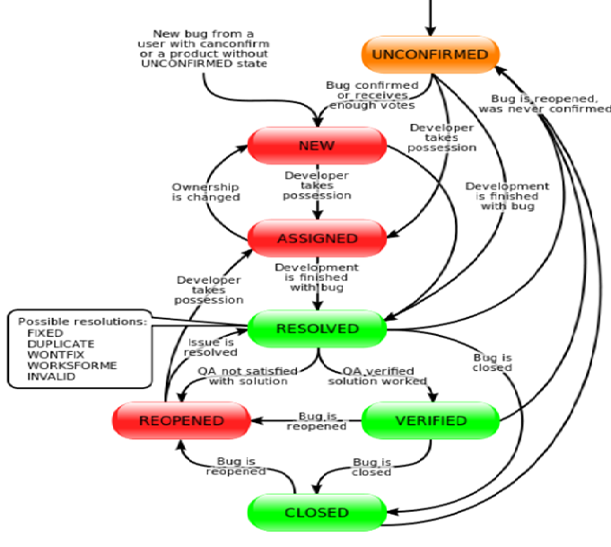
4. Software Bug/Defect Tracking Tools : Bugzilla

